Slide 1
Solving SuDoKu Using
SET Operations
By
Pradeep Kashyap R.
8th sem CS 'A'
USN: 4JC10CS403

Slide 2
Introduction
Sudoku is a logical, number placement Puzzle.
The objective is to fill 9x9 grid such that each row, each coloumn, and each 3x3 sub-grid to get values from 1-9 without repetition.

Slide 3
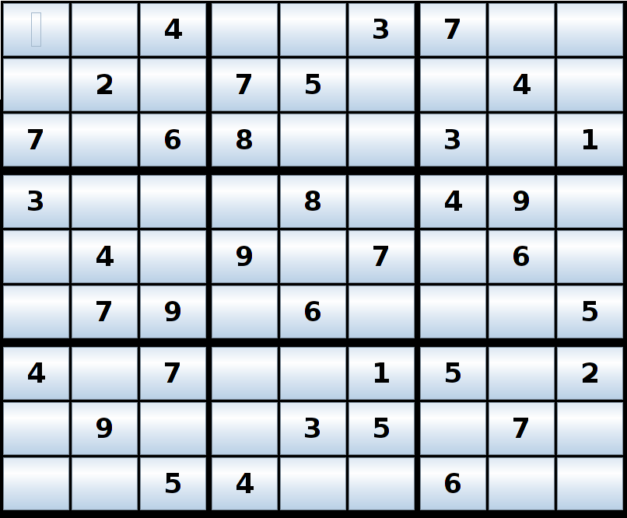
It Looks like this !!
9 Columns
9 Rows
9
boxes

Slide 4
Lets see how to solve !
9 Columns
9 Rows
9
boxes

Slide 5


Lets see how to solve !

Slide 6
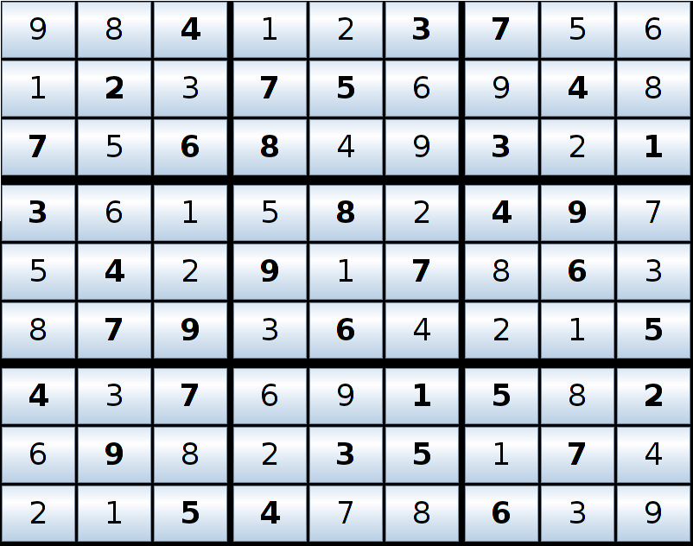
Lets see how to solve !

Slide 7
Solving Using SETs
Why sets?
Properties of sudoku such as no “Repetition” of values in same row, same column and in the same Box (3x3 grid) and
Each cell can have a “Set” of Possible Values which can occupy it; makes SET suitable Data Structure.
UNION and DIFFERENCE and the most frequently used operations to solve Sudoku.
This technique determines whether a given sudoku is solvable without guess or not.

Slide 8
Implementation Details
Implementation of SET using BitVector
Base
0
1
2
3
4
5
6
7
8
4 bytes
9 bits
4 bytes
Pointer
Union, Intersection, difference are O(1)
–
∩
OR operation AND opeartion A-B = A B

Slide 9
Implementation Details
Union Using OR-operation
1
1
0
0
1
1
1
1
0
0
0
0
0
0
1
1
0
0
0
0
{2,3,7}
1
1
1
0
0
0
1
0
0
1
{1,2,6,9}
1
1
1
1
0
0
1
1
0
1
{1,2,3,6,
7,9}

Slide 10
Implementation Details
Intersection Using AND-operation
1
1
0
0
1
1
1
1
0
0
0
0
0
0
1
1
0
0
0
0
{2,3,7}
&
1
1
1
0
0
0
1
0
0
1
{1,2,6,9}
1
0
1
0
0
0
0
0
0
0
{2}

Slide 11
Implementation Details
Difference Using AND and Complement
1
1
0
0
1
1
1
1
0
0
0
0
0
0
1
1
0
0
0
0
{2,3,7}
&
Flip
Bits
1
1
1
0
1
0
0
1
0
1
0
1
1
0
0
1
0
1
1
0
{3,4,5,
7,8}
1
0
0
1
0
0
0
1
0
0
{3, 7}

Slide 12
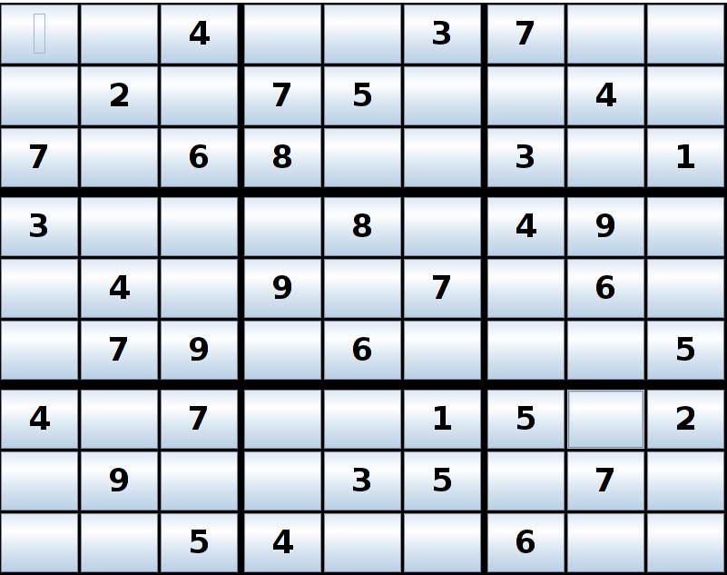
Solving Using SETs

Slide 13
Solving Using SETs
PossibleValues are
PossibleValues are
{ 1, 3, 8 }
{ 1, 5, 8 }
PossibleValues are
{ 1, 5, 8, 9 }
PossibleValues are
{ 1, 8, 9 }
PossibleValues is/are
{ 5 }

Slide 14
Defining PossibleValues
Mathematically
C = { 1,2, . . . ,9 }

≤
≤
0 i , j 8
Cell[i][j].PossibleValues=
–
C
(row[i]
∪
column[j]
∪
Box( boxVal(i,j) ) )
Where,
boxVal(i,j) =
(⌊
*
(⌊
⌋)
i / 3
⌋)
3 +
j / 3

Slide 15
Methods of solving sudoku
Using SET operations
Basic Filling.
Filling by Elimination.
Filling By
- Row Analysis.
- Column Analysis.

Slide 16
Methods of solving sudoku
Using SET operations : Basic Filling
Basic Filling:
In this technique cells whose cardinality of PossibleValues is one are filled. i.e
If |PossibleValues| = 1 then fill the cell with the only value in the Set PossibleValues.

Slide 17
Methods of solving sudoku
Using SET operations : Basic Filling
PossibleValues =
{ 1,2,3,4,5,6,7,8,9} -
( { 1,3,6,7,8 }
∪
{ 2,4,7,9}
∪
{ 2,4,6,7} )

Slide 18
Methods of solving sudoku
Using SET operations : Basic Filling
PossibleValues =
{ 1,2,3,4,5,6,7,8,9} -
( { 1,3,6,7,8 }
(
∪
{ 2,4,7,9}
∪
{ 2,4,6,7} )

Slide 19
Methods of solving sudoku
Using SET operations : Basic Filling
PossibleValues =
{ 1,2,3,4,5,6,7,8,9} -
(
{ 1,2,3,4,6,7,8,9 }
(
∪
{ 2,4,6,7} )

Slide 20
Methods of solving sudoku
Using SET operations : Basic Filling
PossibleValues =
{ 1,2,3,4,5,6,7,8,9} -
( { 1,2,3,4,6,7,8,9 } )

Slide 21
Methods of solving sudoku
Using SET operations : Basic Filling
PossibleValues =
{ 5 }
5
2
6
9

Slide 22
Methods of solving sudoku
Using SET operations : Basic Filling
Using this method, all Sudokus of 'very easy' and 'easy' level are solvable.
Very few Sudoks of 'medium' level can also be solved.

Slide 23
Methods of solving sudoku
Using SET operations :Filling by Elimination
Filling By elimination:
In this technique, a cell 'c' in a box 'b' is filled with a value 'x' if 'x' is not a PossibleValue in other cells in the same box 'b'. i.e.
'x' can appear only in the cell 'c' of the box 'b'

Slide 24
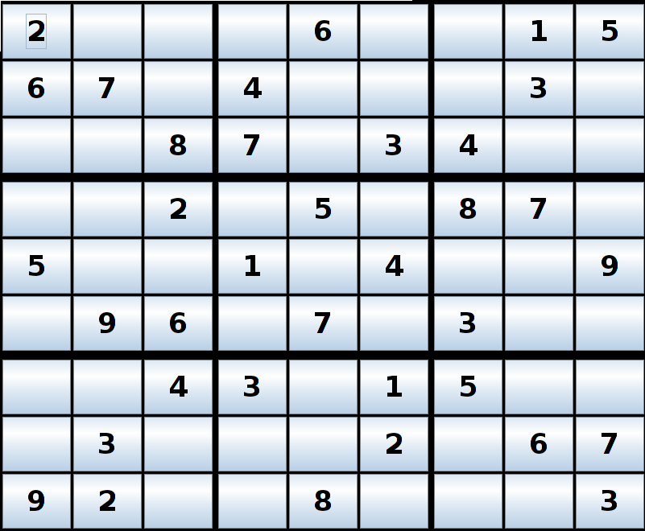
Filling by elimination
3
5
4
4

Slide 25
Defining Mathematically :
Filling by Elimination
If a cell 'j' is under consideration in the BOX 'i' then
Result =
BOX[i] . cell[ j ]. PossibleValues
8
–
∪
–
BOX[i]. cell [q]. PossibleValues,
Where, q j
≠
q = 0
If |Result| = 1 then cell[ j ] = Result

Slide 26
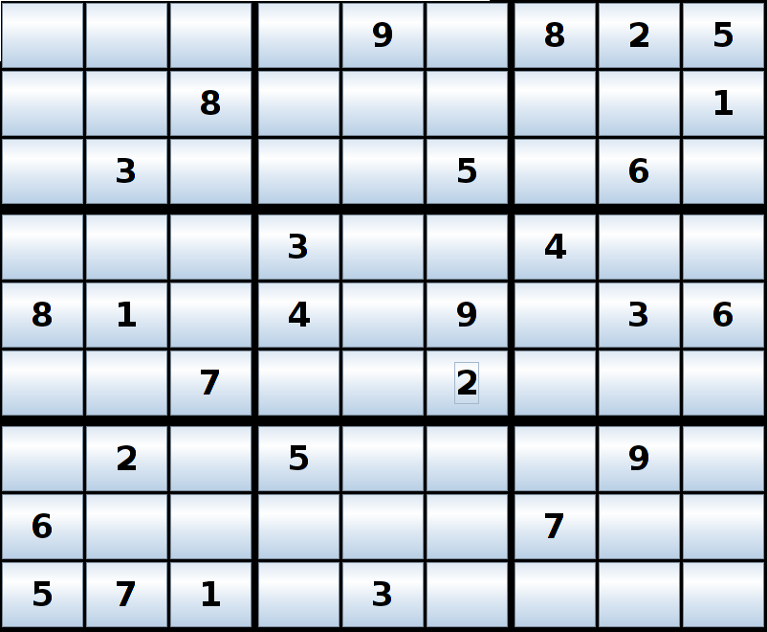
Filling by elimination
–
({1,4,7}
{2,4,9})
∪
∪
∪
∪
∪
Result= {4,5,6,9 }
{4,6}
{4,6}
{2,4,7,9}
{1,2,4,7,9}

Slide 27
Filling by elimination
–
Result= {4,5,6,9 }
{ 1, 2, 4, 6, 7, 9}

Slide 28
Filling by elimination
Result= {5}
5

Slide 29
Methods of solving sudoku
Using SET operations :Filling by Elimination
Using this method, all Sudokus of 'medium' are solvable.

Slide 30
Methods of solving sudoku
Using SET operations :Filling by Row / Column Analysis
Filling By Row Analysis:
In this technique, a cell 'c' of a row 'r' is filled with a value 'x' if 'x' is not a Possible Value in any of the other cell in the same row. i.e.
A cell in a row is filled with a value if it cannot appear in any other cell in the same row

Slide 31
Methods of solving sudoku
Using SET operations :Filling by Row / Column Analysis
Filling By Column Analysis:
In this technique, a cell 'c' of a column 'L' is filled with a value 'x' if 'x' is not a Possible Value in any of the other cell in the same column. i.e.
A cell in a column is filled with a value if it cannot appear in any other cell in the same column

Slide 32
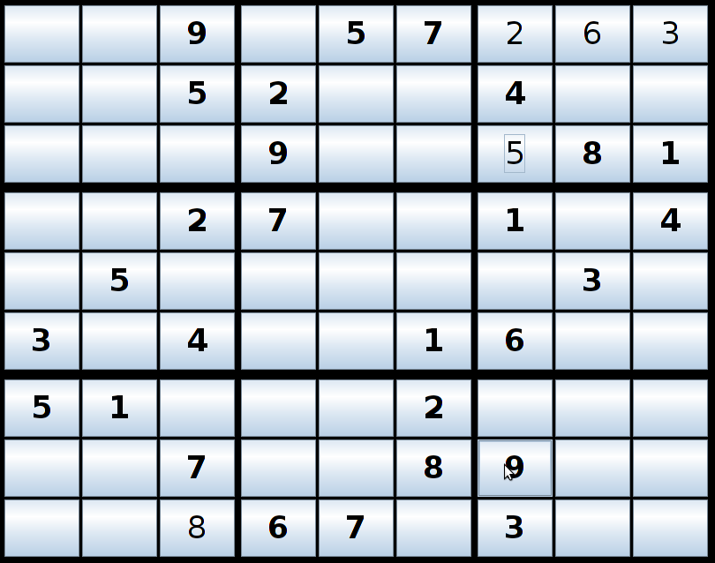
Row/ Column Analysis
Analyzing This
Row for 1
1

Slide 33
Row/ Column Analysis
Analyzing This
Column for 1
1
1

Slide 34
Row/ Column Analysis
Is Filling by Row / Column Analysis necessary to solve and determine whether a sudoku is solvable without guess ??
YES

Slide 35
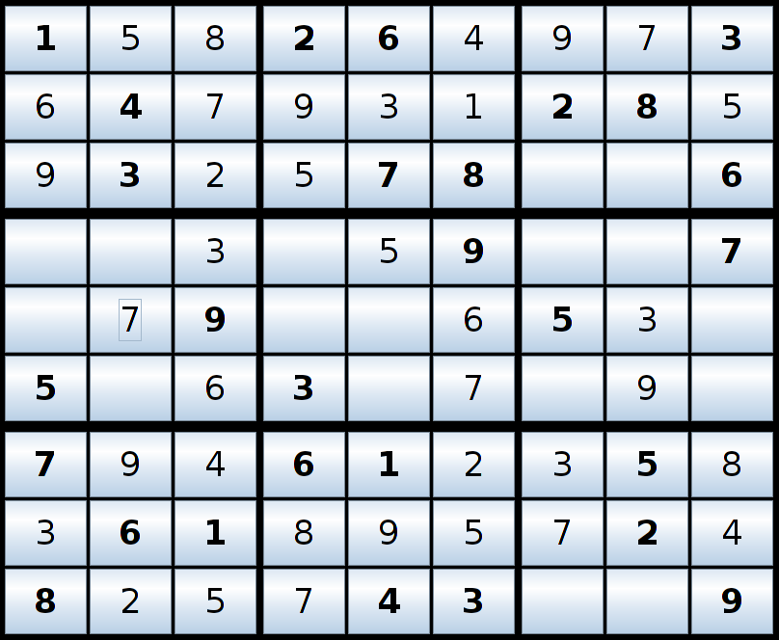
Row/ Column Analysis
Analyzing This
Row for 2
2

Slide 36
Defining Mathematically:
Row / column Analysis
If a cell 'j' is under consideration in the ROW 'r' then
8
∪
Result =
cell[ r ][ j ].PossibleValues
–
–
Cell [ r ] [q]. PossibleValues,
Where, q j
≠
q = 0
If |Result| = 1 then cell [ r ] [ j ] = Result

Slide 37
Defining Mathematically:
Row / column Analysis
If a cell 'j' is under consideration in the Coloumn 'L' then
8
∪
Result =
cell[ j ][ L ].PossibleValues
–
–
Cell [ q ] [L]. PossibleValues,
Where, q j
≠
q = 0
If |Result| = 1 then cell [ j ] [ L ] = Result

Slide 38
Row/ Column Analysis
–
({2,4,9}
∪
{2,4,9}
∪
{4,5,9}
∪
{2,5} )
Result= {1,2,4,5}

Slide 39
Row/ Column Analysis
1
–
{ 1 }
Result= {1,2,4,5}
{2, 4, 5, 9}

Slide 40
Row/ Column Analysis
Using this method, almost all Sudokus of 'Hard' level can be solved.

Slide 41
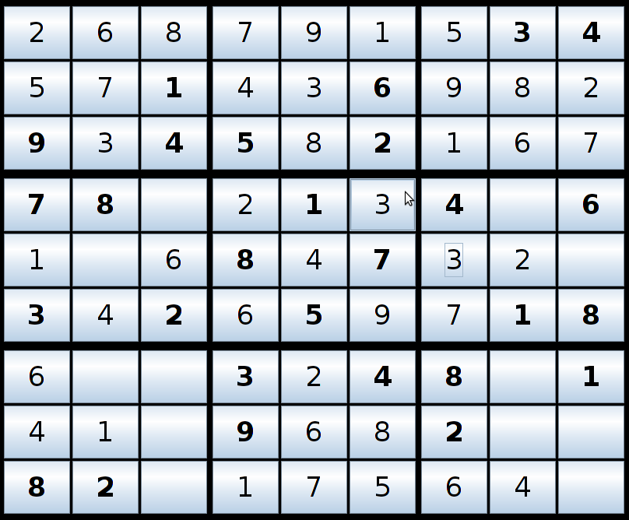
Not all Sudokus are solvable
Without guess

Slide 42
Implementation Details
Tools and languages Used.
Languages Used:
- C++ (Backend)
- Java (Frontend) swings
Tools:
- LaTex (Reporting).
- OpenOffice (presentation).

Slide 43
Implementation Details
Lets execute the program !
Skip implementation details

Slide 44
Comparision and conclusion
- The technique discussed can solve and decide whether a sudoku is solvable without guess or not.
- Set Data structre and associated operation in O(1) helped to solve sudoku in O( n³ )
- Set Data structre was efficient interms of both memory and time.
- we were able to give a mathematical solution to SuDoKu

Slide 45
Comparision and conclusion
- Lot of algorithms exist for generating Sudokus and not for solving them.
General Brute force techniques take
O (n^{n}) for backtracking technique
Without Set Data Structure.
O ( n² x ( 4n² (3n) ) = O ( n² x 12n³ ) = O( n⁵)

Slide 46
Comparision and conclusion
Using Set Data strucature it reduces to
n² x ( 4(1) (3n) ) = O ( n³ )

Slide 47
Thank you :)
Questions ??

